Slide 1
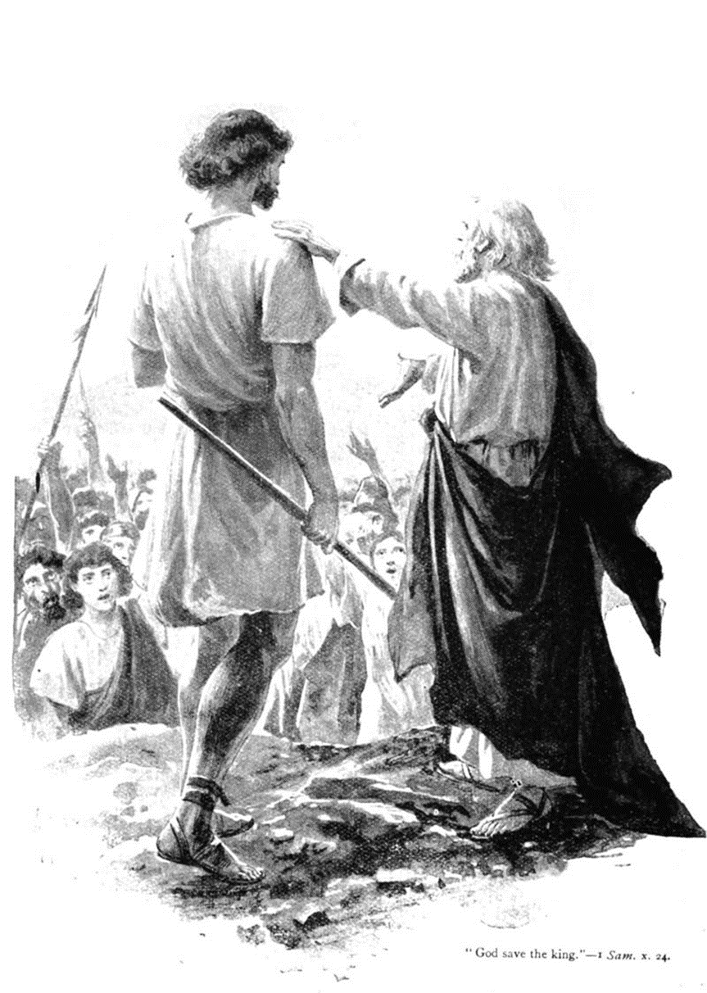
1 Samuel 12
Reckoning, Rebuke and Warning

Slide 2
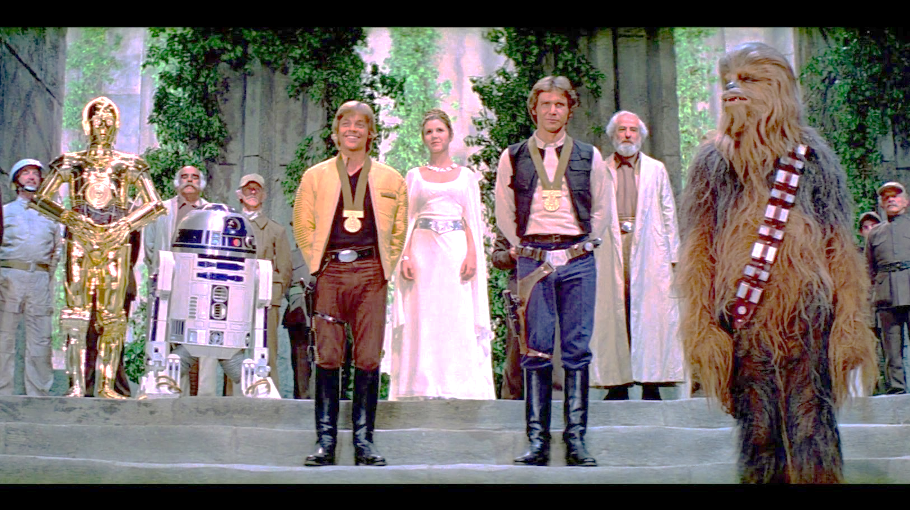
Notes:
Saul blessing samuel

Slide 3
PROBLEM: People take and substitute SIN for personal security.

Slide 4

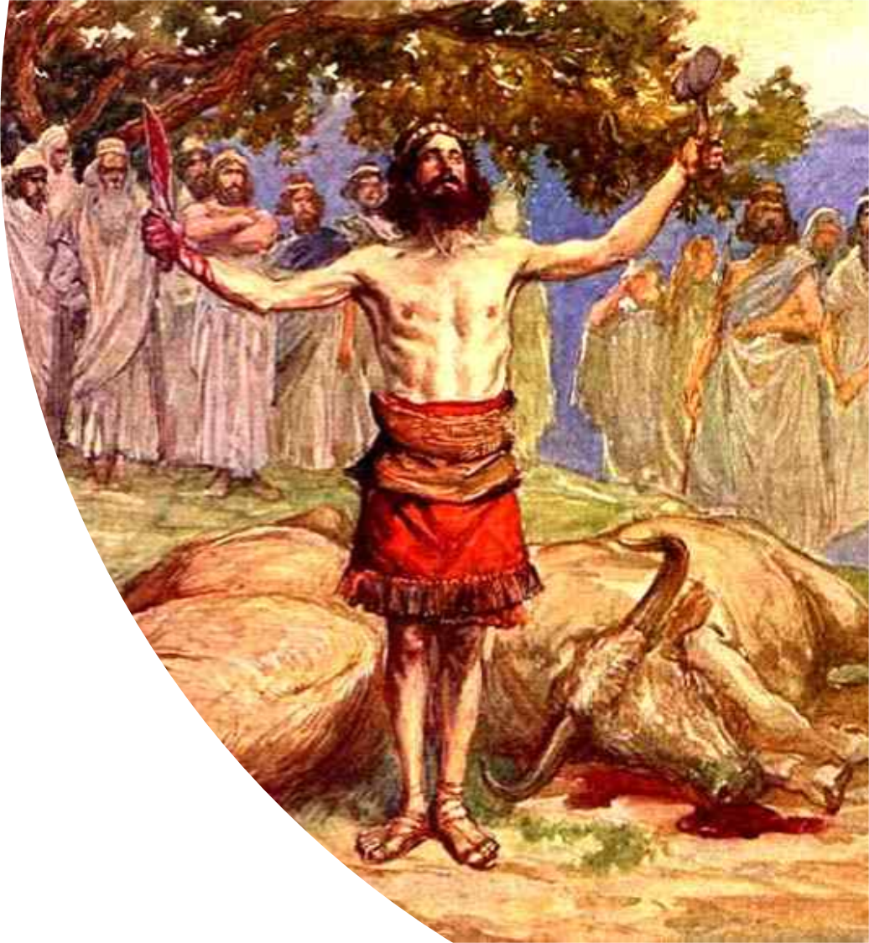
Samuel’s Integrity.
Remember, Samuel’s sons are a problem, this was one of the contributing factors to Israel’s request for a king…
“Here am I”
Samuel’s whole life has been dedicated to the edification of Israel.
Saul was willing to take all the oxen from Israel.

Slide 5
We must live our lives so that we can be called to account.

Slide 6
Acts 20:25-27 And now, behold, I know that ye all, among whom I have gone preaching the kingdom of God, shall see my face no more. 26 Wherefore I take you to record this day, that I am pure from the blood of all men. 27 For I have not shunned to declare unto you all the counsel of God.
2 Timothy 3:10-11 But thou hast fully known my doctrine, manner of life, purpose, faith, longsuffering, charity, patience, 11 Persecutions, afflictions, which came unto me at Antioch, at Iconium, at Lystra; what persecutions I endured: but out of them all the Lord delivered me.

Slide 7
John 8:46 Which of you convinceth me of sin? And if I say the truth, why do ye not believe me?
1 Corinthians 15:58 Therefore, my beloved brethren, be ye stedfast, unmoveable, always abounding in the work of the Lord, forasmuch as ye know that your labour is not in vain in the Lord.

Slide 8
Samuel’s Integrity.
Any discipline that would come from
God to Israel was not Samuel’s fault!
Samuel has 2 witnesses that he was
right with Israel.
1. God and 2. His anointed, Saul.
So Samuel is retired as a judge in Israel,
but not as their SPIRITUAL leader.
Samuel is still a prophet. Israel needs to
hear from him!

Slide 9
Psalm 71:17-18 O God, thou hast taught me from my youth: and hitherto have I declared thy wondrous works. 18 Now also when I am old and grayheaded, O God, forsake me not; until I have shewed thy strength unto this generation, and thy power to every one that is to come.

Slide 10
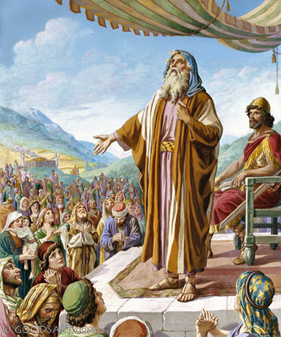
Israel’s Insolence.
Samuel witnesses of Israel’s failures.
When you come out of the world
and in the LORD – you are putting
your trust in the LORD.
Live like that’s really true.
God has been nothing but good to
His people!
Through fear of Ammon Israel
sought a king to protect them.
Saul: The result of man’s DEMANDS.

Slide 11
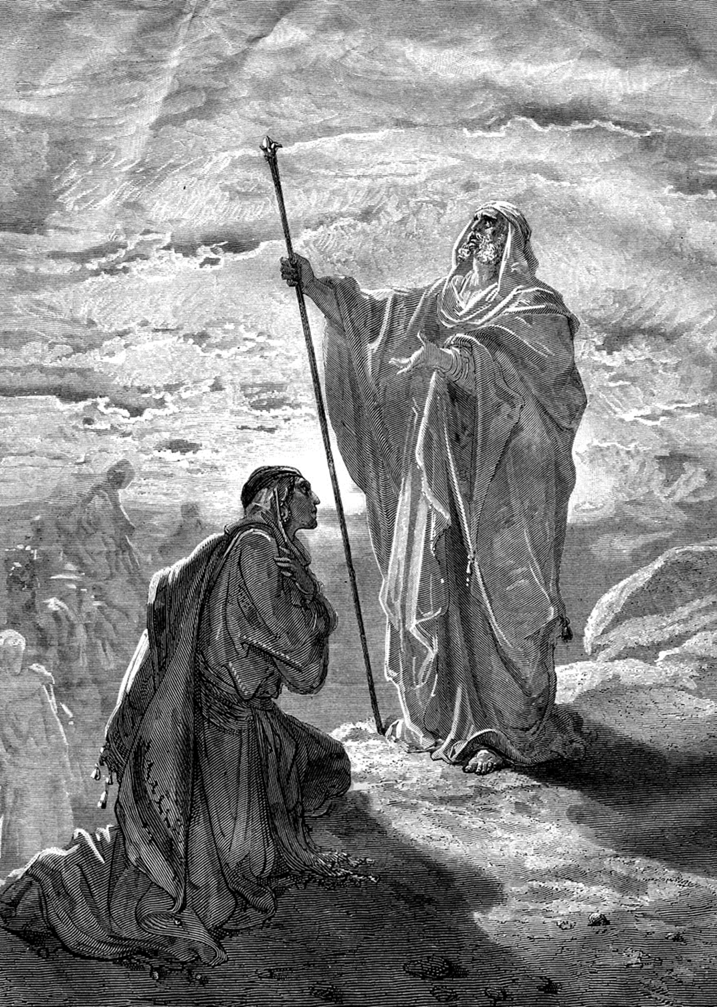
Samuel’s Instruction.
A warning.
That we must take to heart!

Slide 12
Heb12:6-11 For whom the Lord loveth he chasteneth, and scourgeth every son whom he receiveth. 7 If ye endure chastening, God dealeth with you as with sons; for what son is he whom the father chasteneth not? 8 But if ye be without chastisement, whereof all are partakers, then are ye bastards, and not sons. 9 Furthermore we have had fathers of our flesh which corrected us, and we gave them reverence: shall we not much rather be in subjection unto the Father of spirits, and live? 10 For they verily for a few days chastened us after their own pleasure; but he for our profit, that we might be partakers of his holiness. 11 Now no chastening for the present seemeth to be joyous, but grievous: nevertheless afterward it yieldeth the peaceable fruit of righteousness unto them which are exercised thereby.

Slide 13
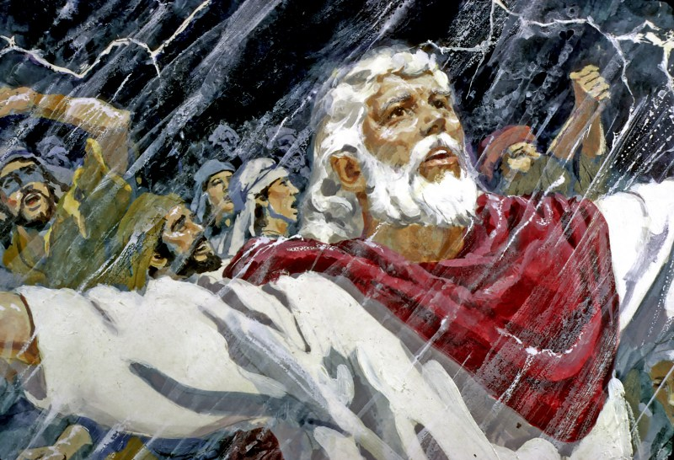
God’s Input.
Successful rebellion never
validates rebellion.
Your sin will always find you out.
Usually, rain is blessing. Not during harvest. Rain can ruin crops.
This is so sobering!
Psalm 18:13 The LORD also thundered in the heavens,
Revelation 19:6 And I heard as it were the voice of a great multitude, and as the voice of many waters, and as the voice of mighty thunderings, saying, Alleluia: for the Lord God omnipotent reigneth.

Slide 14
God’s Input.
This is so amazing!
The confidence that the LORD
and Samuel had in each other!
John 15:7 If ye abide in me, and my words abide in you, ye shall ask what ye will, and it shall be done unto you.
Growing leaders: stay faithful.

Slide 15
God’s Input.
The message?
Repent. Then, just do right moving forward!
Whatever others do, Samuel is COMMITED to what is right and true before the LORD!
Prayerlessness for God’s people is sin against God!

Slide 16
Romans 1:9 For God is my witness, whom I serve with my spirit in the gospel of his Son, that without ceasing I make mention of you always in my prayers;

Slide 17
Deuteronomy 28:36 The LORD shall bring thee, and thy king which thou shalt set over thee, unto a nation which neither thou nor thy fathers have known; and there shalt thou serve other gods, wood and stone.
Deut 28:41 Thou shalt beget sons and daughters, but thou shalt not enjoy them; for they shall go into captivity.
Deut 28:45 Moreover all these curses shall come upon thee, and shall pursue thee, and overtake thee, till thou be destroyed; because thou hearkenedst not unto the voice of the LORD thy God, to keep his commandments and his statutes which he commanded thee:

Slide 18
You can’t teach the things of God, if you do not know the Word of God!

